Slide 1
UCSC Course Finder
Ian Zentner (PO)
Justin Ewing
Umit Ceylan
Joseph Rozo

Slide 2
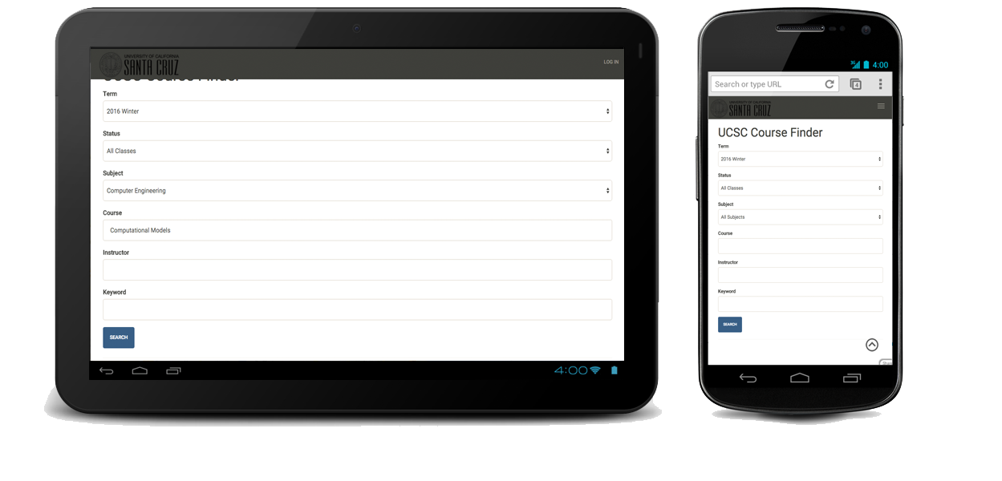
I need to find a class…
UCSC Course Finder is an attempt to make finding a class easier, more intuitive, and most of all accessible by a mobile device.

Slide 3
Goals To Achieve
Mobile Friendly
Intuitive
Easy to Use Search Functionality
Visually Appealing
Real-time Database
User Accounts
Location to the Classroom

Slide 4
Goals Accomplished
Multiple Client Requests
Back to Top Menu
Additional Class Information
Multiparameter Search Functionality

Slide 5
Technologies used
Web2Py
HTML
CSS
JavaScript
JQuery
Python
Slack
Trello
Git/GitHub

Slide 6
Challenges
Using new technologies
Fitting the meetings between our busy school schedule
Adjusting to Agile Methodology
Git Merging

Slide 7
Enjoyed
Learning New Technologies
Full Stack Web Development
Developing Team Skills
Working on a Team

Slide 8
Did not Enjoy
Meetings
Frustrations With the New Technology
Working on a Team
Juggling Coursework

Slide 9
Learned
What worked
Communication
Team Planning
Working Together
Being Organized

Slide 10
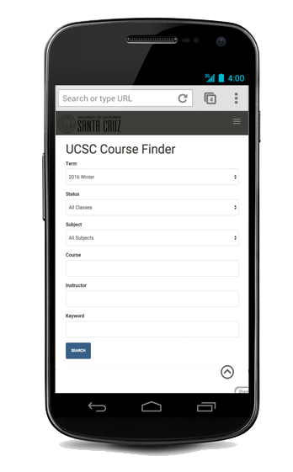
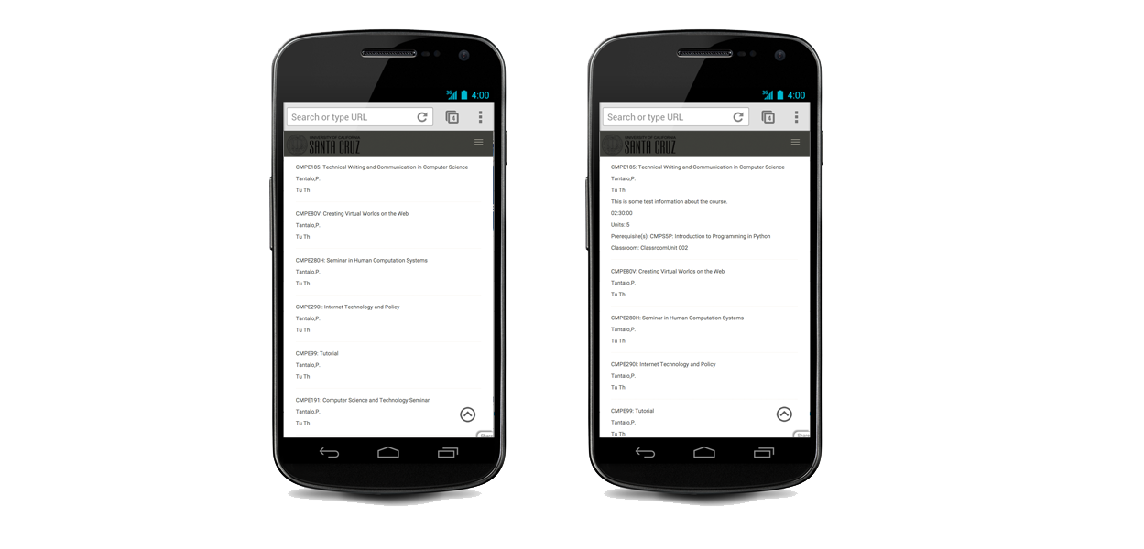
Questions

